Slide 1




Sharefests 2024
September 14- Hood UMC (SW)
September 21- Santa Fe Christian (NE)
September 28- Red Bridge UMC (KC)
October 4- CrossRoads Global Methodist (SE)
October 5- InterServ (NW)
October 12- LifeWise STL (STL) & Tipton UMC (Central)
Donation Drop-Off: 9:30-11:30 AM
For event information or to
sign up as a volunteer, visit festivalofsharing.org/sharefests.

Slide 2
Sharefests 2024
September 14
Hood UMC (SW)
September 21
Santa Fe Christian (NE)
September 28
Red Bridge UMC (KC)
Donation Drop-Off: 9:30-11:30 AM
For event information or to
sign up as a volunteer, visit festivalofsharing.org/sharefests.

Slide 3
Sharefests 2024
October 4
CrossRoads Global Methodist (SE)
October 5
InterServ (NW)
October 12
LifeWise STL (STL) & Tipton UMC (Central)
Donation Drop-Off: 9:30-11:30 AM
For event information or to
sign up as a volunteer, visit festivalofsharing.org/sharefests.

Slide 4
Sharefests 2024
September 14
Hood UMC (SW)
139 North Walnut Avenue
Republic, MO, 65738
Donation Drop-Off: 9:30-11:30 AM
For event information or to
sign up as a volunteer, visit festivalofsharing.org/sharefests.

Slide 5
Sharefests 2024
September 21
Santa Fe Christian (NE)
35546 State Highway D
Santa Fe, MO, 65282
Donation Drop-Off: 9:30-11:30 AM
For event information or to
sign up as a volunteer, visit festivalofsharing.org/sharefests.

Slide 6
Sharefests 2024
September 28
Red Bridge UMC
636 East 117th Street
Kansas City, MO, 64131
Donation Drop-Off: 9:30-11:30 AM
For event information or to
sign up as a volunteer, visit festivalofsharing.org/sharefests.

Slide 7
Sharefests 2024
October 4
CrossRoads Global Methodist
501 South Walnut Street
Dexter, MO, 63841
Donation Drop-Off: 9:30-11:30 AM
For event information or to
sign up as a volunteer, visit festivalofsharing.org/sharefests.

Slide 8
Sharefests 2024
October 5
InterServ (NW)
5400 King Hill Avenue
Saint Joseph, MO, 64504
Donation Drop-Off: 9:30-11:30 AM
For event information or to
sign up as a volunteer, visit festivalofsharing.org/sharefests.

Slide 9
Sharefests 2024
October 12
LifeWise STL (STL)
1321 South 11th Street
St. Louis, MO, 63104
Tipton UMC (Central)
204 E US Hwy 50
Tipton, MO, 65081
Donation Drop-Off: 9:30-11:30 AM
For event information or to
sign up as a volunteer, visit festivalofsharing.org/sharefests.

Slide 10
Sharefests 2024
Most Needed Items
MO Personal Hygiene Kits
MO Paper Product Kits
MO Family Food Boxes
Donation Drop-Off: 9:30-11:30 AM
For event information or to
sign up as a volunteer, visit festivalofsharing.org/sharefests.

Slide 11
Sharefests 2024
2024 Booklet
Individual Kit List PDFs
Sharefest Fliers
Quilt Auction Fliers & Form
Digital Copies Available:
Festivalofsharing.org/kits
Festivalofsharing.org/media
Donation Drop-Off: 9:30-11:30 AM
For event information or to
sign up as a volunteer, visit festivalofsharing.org/sharefests.

Slide 12
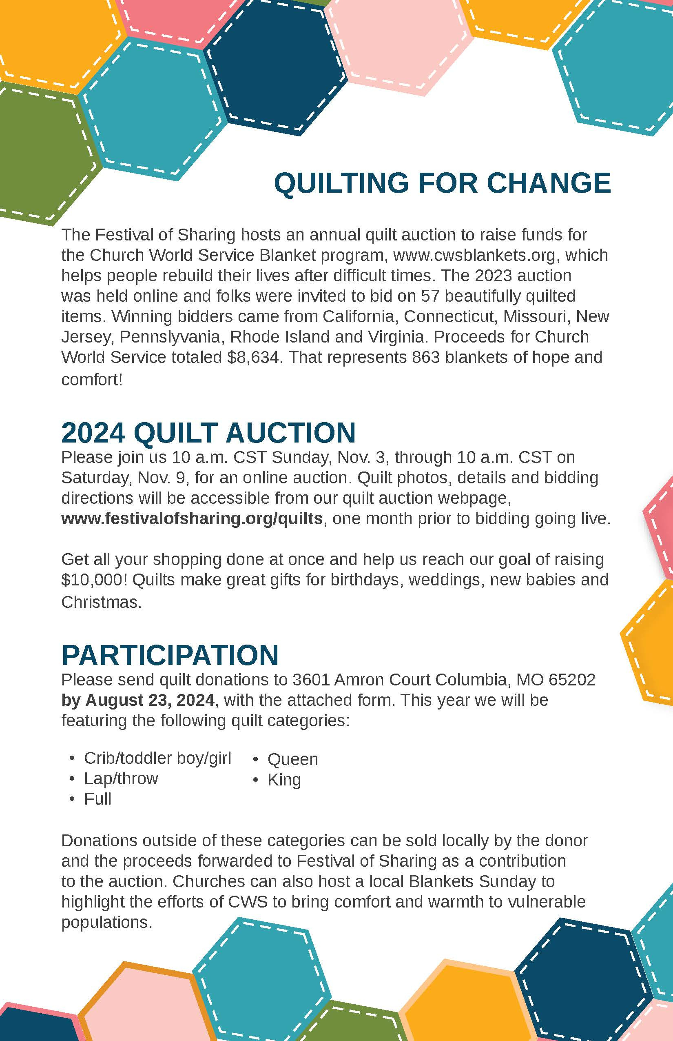
2024 Online Quilt Auction
Sunday, November 3 - Saturday November 9
10 AM CST - 10 AM CST
festivalofsharing.org/quilt-auction

